Slide 1
Data Structures and Algorithms
CSC206
Unit 7:Searching and Hashing
Shyam Sunder Khatiwada

Slide 2
Searching
Searching is a process of checking and finding an element from a list of elements.
Let X be a collection of data elements, i.e., X is a linear array of say n elements. If we want to find the presence of an element “data” in A, then we have to search for it.
The search is successful if data does appear in A and unsuccessful if otherwise.
There are several types of searching techniques; one has some advantages over other.
Some of the techniques are :
Linear or Sequential Searching (Small arrays and unsorted arrays)
Binary Searching (Large arrays and sorted arrays)

Slide 3
Linear Search
Linear search is also called as sequential search algorithm.
It is the simplest searching algorithm.
In Linear search, we simply traverse the list completely and match each element of the list with the item whose location is to be found.
If the match is found, then the location of the item is returned; otherwise, the algorithm returns NULL.
It is widely used to search an element from the unordered list, i.e., the list in which items are not sorted. The worst-case time complexity of linear search is O(n).

Slide 4
Linear Search Algorithm
Linear search is implemented using following steps...
Step 1 - Read the search element from the user.
Step 2 - Compare the search element with the first element in the list.
Step 3 - If both are matched, then display "Given element is found!!!" and terminate the function
Step 4 - If both are not matched, then compare search element with the next element in the list.
Step 5 - Repeat steps 3 and 4 until search element is compared with last element in the list.
Step 6 - If last element in the list also doesn't match, then display "Element is not found!!!" and terminate the function.

Slide 5
Implementation:
#include<stdio.h>
#include<conio.h>
void main(){
int list[20],size,i,sElement;
printf("Enter size of the list: ");
scanf("%d",&size);
printf("Enter any %d integer values: ",size);
for(i = 0; i < size; i++)
scanf("%d",&list[i]);
printf("Enter the element to be Search: ");
scanf("%d",&sElement);
// Linear Search Logic
for(i = 0; i < size; i++)
{
if(sElement == list[i])
{
printf("Element is found at %d index", i);
break;
}
}
if(i == size)
printf("Given element is not found in the list!!!");
getch();
}

Slide 6
Linear Search Analysis: Time Complexity
Case | Time Complexity
Best Case | O(1)
Average Case | O(n)
Worst Case | O(n)
Analysis Worst case is target item not in the list or at the end,
N Comparisons - Order (n) Complexity
Best Case is target is at the first position
Order(1) Complexity
Average case
(1+2+......+(n-1)+n → n(n+1)/2 → Order(n)

Slide 7
Binary Search
Binary search can be implemented only on a sorted list of items. If the elements are not sorted already, we need to sort them first.
Binary search follows divide and conquer approach in which, the list is divided into two halves and the item is compared with the middle element of the list.
If the match is found then, the location of middle element is returned otherwise, we search into either of the halves depending upon the result produced through the match.
Binary search algorithm is to reduce the time complexity of search on sorted array to O(Log n)

Slide 8
Binary Search: Algorithm
Step 1- Find the middle index using (first+last)/2.
Step 2- If element at middle index == number , print middle index
Step 3- If element at middle index > number, Now last = middle index -1 . go to step 1.
Step 4- If element at middle index < number, Now first = middle index +1. go to step 1.
Step 5- Continue until second step gets evaluated or middle index becomes zero.
Step 6- Print number not found, if middle index becomes zero.

Slide 9
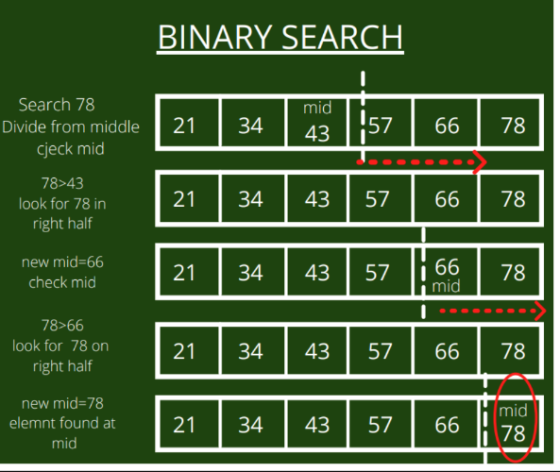
Binary Search

Slide 10
Binary Search: Implementation
#include<stdio.h>
#include<conio.h>
void main()
{
int first, last, middle, size, i, sElement, list[100];
clrscr();
printf("Enter the size of the list: ");
scanf("%d",&size);
printf("Enter %d integer values in Assending order\n", size);
for (i = 0; i < size; i++)
scanf("%d",&list[i]);
printf("Enter value to be search: ");
scanf("%d", &sElement);
first = 0;
last = size - 1;
middle = (first+last)/2;

Slide 11
Binary Search: Implementation
while (first <= last) {
if (list[middle] < sElement)
first = middle + 1;
else if (list[middle] == sElement) {
printf("Element found at index %d.\n",middle);
break;
}
else
last = middle - 1;
middle = (first + last)/2;
}
if (first > last)
printf("Element Not found in the list.");
getch();
}

Slide 12
Binary Search: Time Complexity
Case | Time Complexity
Best Case | O(1)
Average Case | O(logn)
Worst Case | O(logn)

Slide 13
Hashing
Hashing is the process of generating a value from a text or a list of numbers using a mathematical function known as a hash function.There are many hash functions that use numeric or alphanumeric keys.
Types of Hash Functions:
Division method
Mid square method
Digit folding method

Slide 14
Hash Function: Division method
This is the easiest method to create a hash function. The hash function can be described as − h(k) = k mod n
Here, h(k) is the hash value obtained by dividing the key value k by size of hash table n using the remainder. It is best that n is a prime number as that makes sure the keys are distributed with more uniformity. An example of the Division Method is as follows −
k=1276
n=10
h(1276) = 1276 mod 10
= 6
The hash value obtained is 6
A disadvantage of the division method id that consecutive keys map to consecutive hash values in the hash table. This leads to a poor performance.

Slide 15
Hash Function: Mid Square method
The mid square method is a very good hash function. It involves squaring the value of the key and then extracting the middle r digits as the hash value. The value of r can be decided according to the size of the hash table.
An example of the Mid Square Method is as follows −
Suppose the hash table has 100 memory locations. So r=2 because two digits are required to map the key to memory location.
k = 50
k*k = 2500
h(50) = 50
The hash value obtained is 50

Slide 16
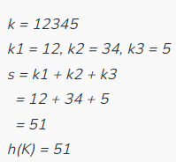
Hash Function: Folding method
This method involves two steps:
Divide the key-value k into a number of parts i.e. k1, k2, k3,….,kn, where each part has the same number of digits except for the last part that can have lesser digits than the other parts.
Add the individual parts. The hash value is obtained by ignoring the last carry if any.
Formula:
k = k1, k2, k3, k4, ….., kn s = k1+ k2 + k3 + k4 +….+ kn h(K)= s
Here, s is obtained by adding the parts of the key k

Slide 17
Characteristics of Hash Function:
The hash function should generate different hash values for the similar string.
The hash function is easy to understand and simple to compute.
The hash function should produce the keys which will get distributed, uniformly over an array.
A number of collisions should be less while placing the data in the hash table.
The hash function is a perfect hash function when it uses all the input data.

Slide 18
Hash Table
A hash table is a data structure that is used to store keys/value pairs.
It uses a hash function to compute an index into an array in which an element will be inserted or searched.
By using a good hash function, hashing can work well.
Under reasonable assumptions, the average time required for an element in a hash table is O(1).

Slide 19
Example
Suppose we have a set of strings {“abc”,”def”,”ghi”} that we’d like to store in a table. Our objective here is to find or update them quickly from a table, actually in O(1).
We are not concerned about ordering them or maintaining any order at all. Let us think of a simple schema to do this.
Suppose we assign “a”=1, “b”=2, …. etc to all alphabetical characters.
We can then simply compute a number for each of the strings by using the sum of the characters as
“abc”=1+2+3=6, “def”=4+5+6=15, “ghi”=7+8+9=24

Slide 20
Example
If we assume that we have table of size 5 to store these strings, we can compute then location of the string by taking the sum mod 5.
So we will then store “abc” in 6 mod 5 = 1
“def” in 15 mod 5 = 0
“ghi” in 24 mod 5 = 24
0 | 1 | 2 | 3 | 4
def | abc |  |  | ghi

Slide 21
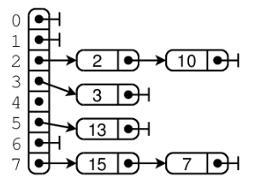
Hash Collision
When the hash function generates the same index for multiple keys, there will be a conflict (what value to be stored in that index). This is called a hash collision.
We can resolve the hash collision using one of the following techniques.
Collision resolution by chaining
Open Addressing: Linear/Quadratic Probing and Double Hashing

Slide 22
Collision Resolution Techniques
Collision Resolution Techniques are the techniques used for resolving or handling collisions.
The process of finding an alternate location is called collision resolution.
Even though hash tables have collision problems, they are more efficient in many cases compared to all other data structures, like search trees.
There are a number of collision resolution techniques, and the most popular are direct chaining and open addressing.

Slide 23
Collision Resolution Techniques
Direct Chaining (Open Hashing): An array of linked list application.
Separate chaining
Open Addressing (Closed Hashing): Array-based implementation
Linear probing (linear search)
Quadratic probing (non-linear search)
Double hashing (use two hash functions)

Slide 24
Collision Resolution by Chaining
In chaining, if a hash function produces the same index for multiple elements, these elements are stored in the same index by using a doubly-linked list.
If j is the slot for multiple elements, it contains a pointer to the head of the list of elements. If no element is present, j contains NIL.
This linked list of slots looks like a chain, so it is called separate chaining.
It is used more when we do not know how many keys to insert or delete.

Slide 25
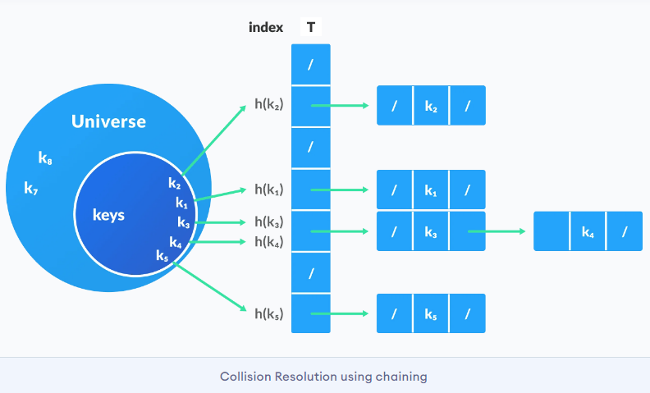
Collision Resolution Techniques

Slide 26
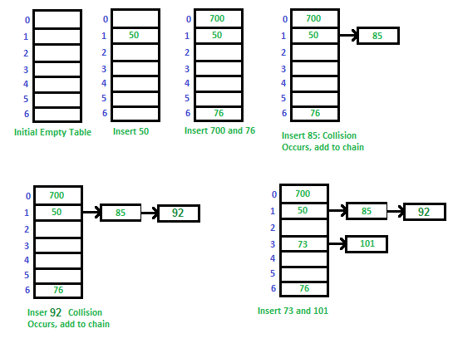
Example- Separate Chaining
Example: Let us consider a simple hash function as “key mod 7” and a sequence of keys as
50, 700, 76, 85, 92, 73, 101

Slide 27
Separate Chaining
Advantages:
Simple to implement
Hash table never fills up, we can always add more elements to chain.
Disadvantages:
Wastage of Space (Some Parts of hash table are never used)
If the chain becomes long, then search time can become O(n) in worst case.
Uses extra space for links.

Slide 28
Open Addressing (Closed Hashing)
Open addressing is collision-resolution method that is used to control the collision in the hashing table.
There is no key stored outside of the hash table.
Therefore, the hash table’s size is never equal to or less than the number of keys. . It is also called closed hashing.
The following techniques are used in open addressing:
Linear probing
Quadratic probing
Double hashing

Slide 29
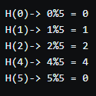
Linear Probing
The idea of linear probing is simple, we take a fixed sized hash table and every time we face a hash collision we linearly traverse the table in a cyclic manner to find the next empty slot.
Assume a scenario where we intend to store the following set of numbers = {0,1,2,4,5,7} into a hash table of size 5 with the help of the following hash function H, such that H(x) = x%5.
So, if we were to map the given data with the given hash function we'll get the corresponding values

Slide 30
Linear Probing
In this case we see a collision of two terms (0 & 5).
In this situation we move linearly down the table to find the first empty slot.
Note that this linear traversal is cyclic in nature, i.e. in the event we exhaust the last element during the search we start again from the beginning until the initial key is reached.
In this case our hash function can be considered as this: H(x, i) = (H(x) + i)%N where N is the size of the table and i represents the linearly increasing variable which starts from 1 (until empty bucket is found).

Slide 31
Linear Probing
Advantage:
Easy to compute
Disadvantage:
The main problem with linear probing is clustering.
Many consecutive elements form groups.
Then it take time to search an element or to find an empty bucket.
Worst time to search an element in linear probing is O(table size).

Slide 32
Quadratic probing
This method lies in the middle of great cache performance and the problem of clustering.
The general idea remains the same, the only difference is that we look at the Q(i) increment at each iteration when looking for an empty bucket, where Q(i) is some quadratic expression of i.
A simple expression of Q would be Q(i) = i^2, in which case the hash function looks something like this:
H(x, i) = (H(x) + i^2)%N

Slide 33
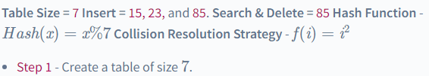
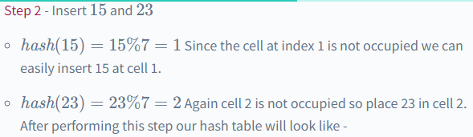
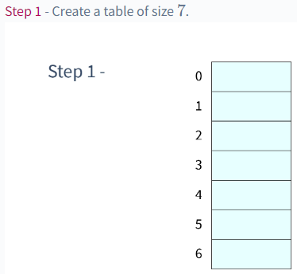
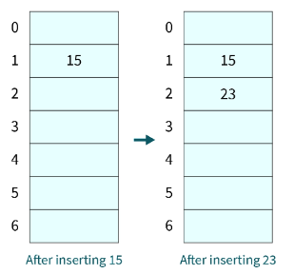
Example of Quadratic probing:

Slide 34
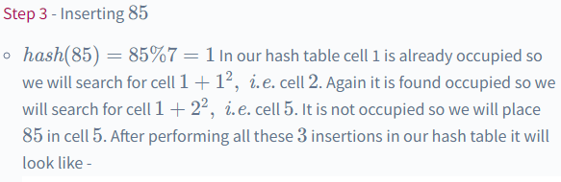
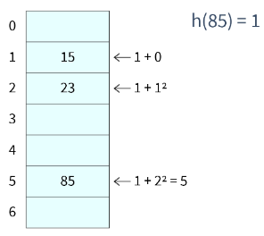

Example of Quadratic probing:

Slide 35
Workout
Mention the disadvantages of Quadratic probing.

Slide 36
Double Hashing
This method is considered one of the best approaches for hashing.
Clustering can be avoided in this technique by using two hash functions.
These hash functions are also used for handling collisions.
The first function calculates the primary location for a value and the second function calculates the probing gap to find an alternative location for a value.

Slide 37
Double Hashing
If computed index is hash1(x) and size of the interval is hash2(x),
hash1(x) = x % n hash2(x) = (n-1) - (x % n) Therefore, index = (hash1(x) + (i * hash2(x))) % n
Here, x is the value that needs an index, n is the table size which should be a prime number, and i is the number of times a collision occurred.
The (n-1) in the hash2(x) function can be any number smaller than the table size. The probing here happens rather randomly, maintaining a consistent manner throughout the hash table.

Slide 38
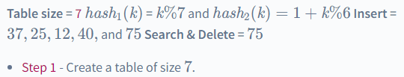
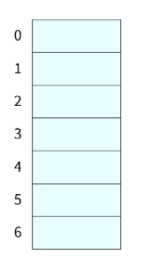
Example:Double Hashing

Slide 39
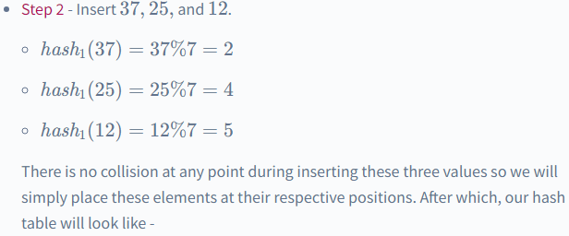
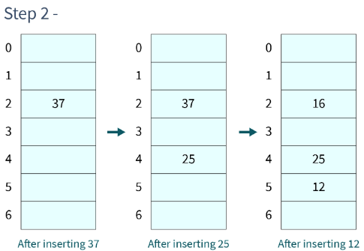
Example:Double Hashing

Slide 40
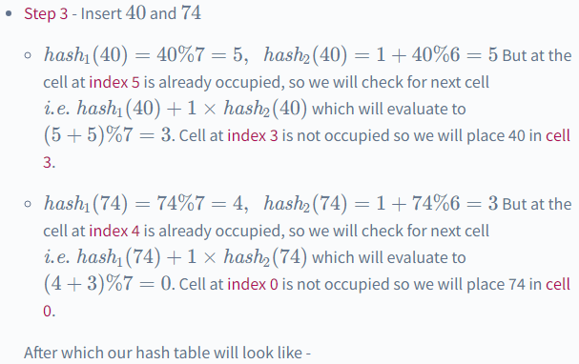
Example:Double Hashing

Slide 41
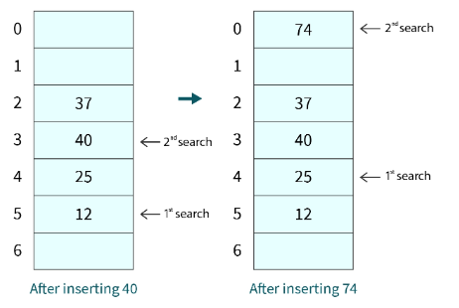
Example:Double Hashing

Slide 42
Advantage of Open Addressing
Open addressing improves cache speed because all the data is stored within the hash table
It properly uses its empty indexes and improves memory efficiency
As there is no linked list or pointer involved, the performance is faster than chaining or open hashing.

Slide 43
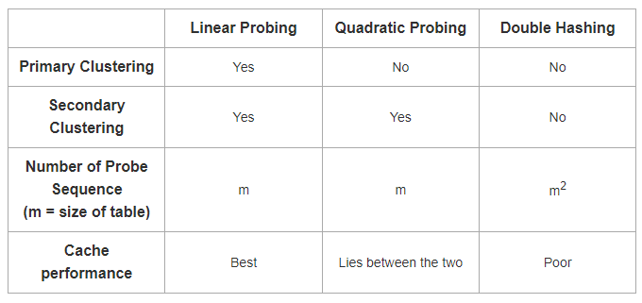
Comparisons of Open Hashing Techniques

Slide 44
Any-Query?
Thank you!!

